Slide 1
Lex – Tool for lexical analysis
G Sudha Sadasivam

Slide 2
Lex
lex is a program (generator) that generates lexical analyzers, (widely used on Unix).
Flex is available for windows also
It is mostly used with Yacc parser generator.
Written by Eric Schmidt and Mike Lesk.
It reads the input stream (specifying the lexical analyzer ) and outputs source code implementing the lexical analyzer in the C programming language.
Lex will read patterns (regular expressions); then produces C code for a lexical analyzer that scans for identifiers.

Slide 3
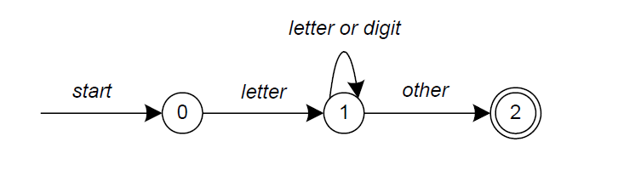
Lex
A simple pattern: letter(letter|digit)*
Regular expressions are translated by lex to a computer program that mimics an FSA.
This pattern matches a string of characters that begins with a single letter followed by zero or more letters or digits.

Slide 4
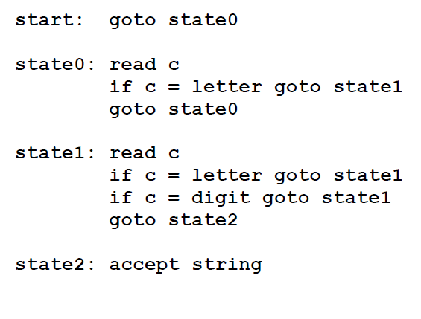
Lex
Some limitations, Lex cannot be used to recognize nested structures such as parentheses, since it only has states and transitions between states.
So, Lex is good at pattern matching, while Yacc is for more challenging tasks.

Slide 5
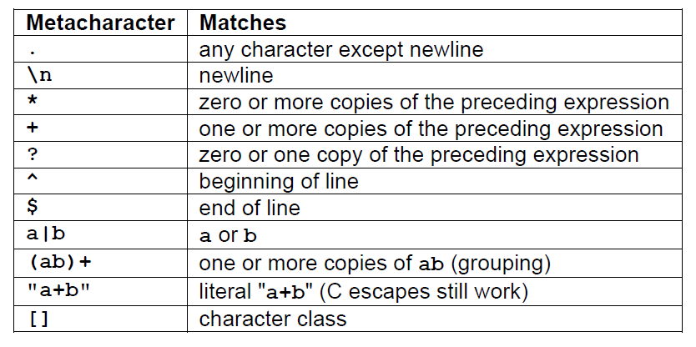
Lex
Pattern Matching Primitives

Slide 6
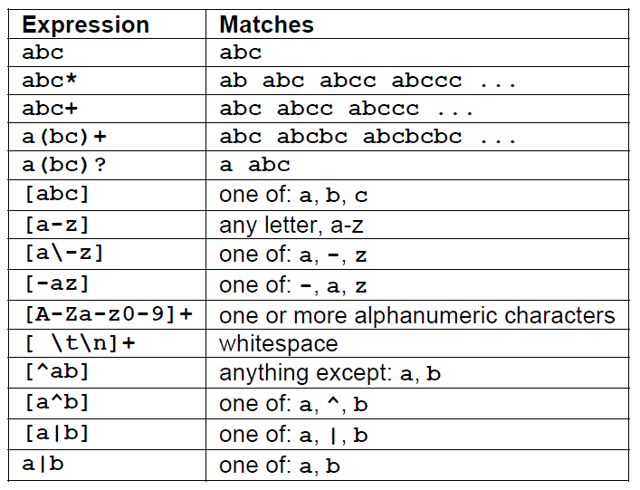
Lex
Pattern Matching examples.

Slide 7
Lex
……..Definitions section……
%%
……Rules section……..
%%
……….C code section (subroutines)……..
The input structure to Lex.

Slide 8
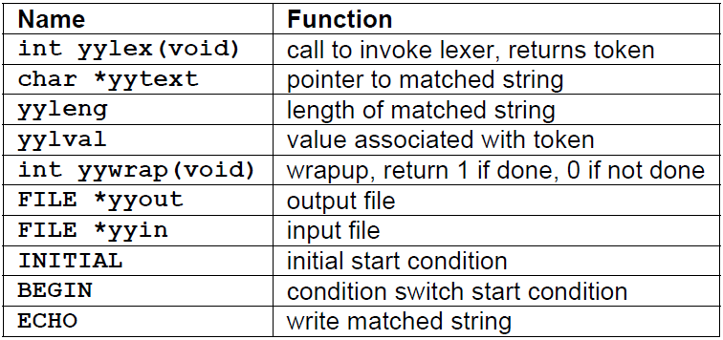
Lex
Lex predefined variables.

Slide 9
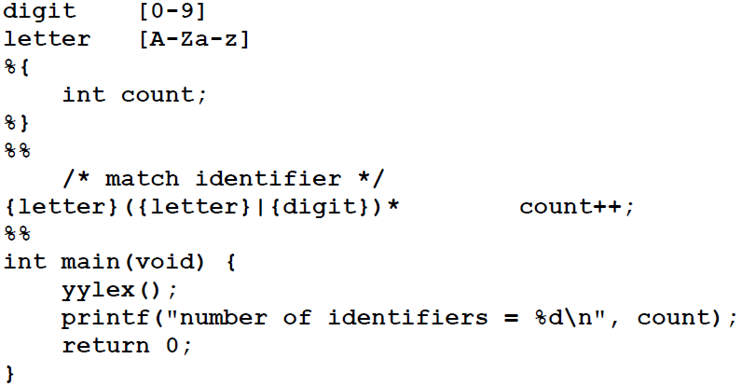
Match Id and print its count
%option noyywrap
int yywrap(void) {
return 1;
}
Whitespace must separate the defining term and the associated expression.
Code in the definitions section is simply copied as-is to the top of the generated C file and must be bracketed with “%{“ and “%}” markers.
substitutions in the rules section are surrounded by braces ({letter}) to distinguish them from literals.

Slide 10
Count char, word, line
%{
int nchar, nword, nline;
%}
%%
\n { nline++; nchar++; }
[^ \t\n]+ { nword++, nchar += yyleng; }
. { nchar++; }
%%
int main(void) {
yylex();
printf("%d\t%d\t%d\n", nchar, nword, nline);
return 0;
}
int yywrap(void) {
return 1;
}

Slide 11
Print line nos
%{
int yylineno;
%}
%%
^(.*)\n printf("%4d\t%s", ++yylineno, yytext);
%%
int main(int argc, char *argv[]) {
yyin = fopen(argv[1], "r");
yylex();
fclose(yyin);
}
int yywrap(void) {
return 1;
}

Slide 12
Hex number
digit [0-9]
alpha [a-fA-F]
hextail ({digit}|{alpha}){1,8}
hex 0[xX]{hextail}
%%
{hex} printf("Found a HEX number %s !", yytext);
. printf("");
%%
main()
{
printf("Give me your input:\n");
yylex(); }

Slide 13
Flex in windows
Install code blocks Click here to download codeblocks-16.01mingw-setup
Install flex Click here to download flex-2.5.4a-1
Set up systems var path
To ……\CodeBlocks\MinGW\bin
C:\Program Files (x86)\CodeBlocks\MinGW\bin
...........\GnuWin32\bin
C:\Program Files (x86)\GnuWin32\bin
Create a folder, Open notepad type in a flex program
- Type in command :- flex filename.l
- Type in command :- gcc lex.yy.c
- Execute/Run for windows command promt :- a.exe

Slide 14
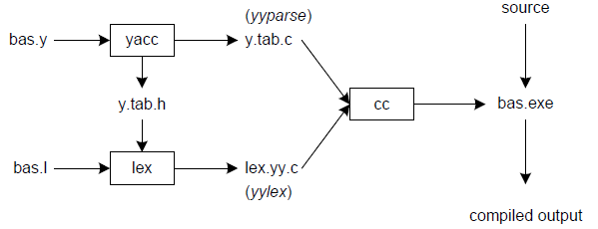
Linking lex&yacc

